Slide 1
205 Feb 7, Class 15
Experiment 2 analysis
Writing feedback
Scientific writing
Introduction: framing the question
Discussion: drawing inferences
Expanding the background research

Slide 2
Experiment 2 data
Exp2_Winter2024.csv/.xlsx
Running the analysis in R
Reporting the results
Making a graph

Slide 3
Results
Main effect of stimulus meaning
F(X,X) = Y.YY, p<.0z
Main effect of deep/shallow encoding
F(X,X) = Y.YY, p<.0z
Interaction
F(X,X) = Y.YY, p<.0z

Slide 4
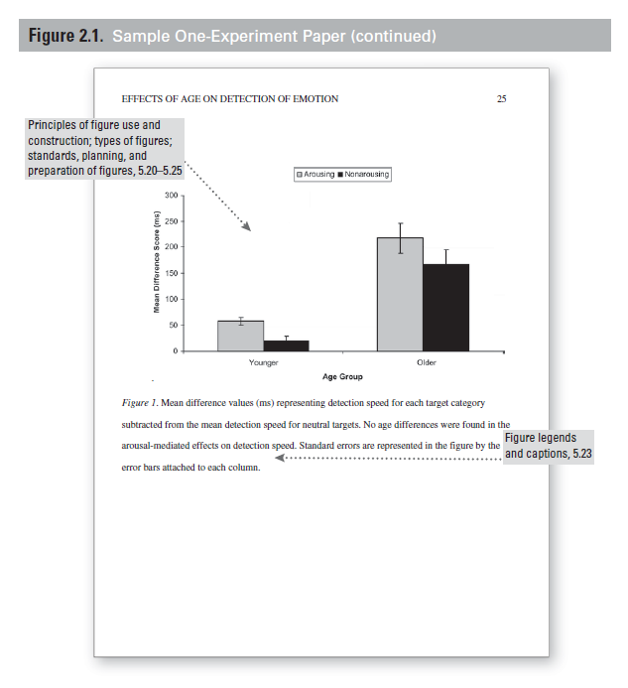
First paper feedback
Follow the provided guidelines
Method: Participants, Materials, Procedure
Use the recommendations on framing Results
Double-check that all the numbers are there and correct
Review the provided sample manuscript paper for overall format

Slide 5
Writeup #2
Include both Experiment 1 and Experiment 2
Methods for Experiment 2 available on Canvas
Make corrections to Experiment 1
Expand the Introduction
What is “deep” encoding?
Why do we hypothesize that “deep” encoding leads to better memory?
What is new about the studies you are reporting?
Expand the Discussion
Summarize results of both experiments
What do they mean with respect to the hypothesis?
Refer back to theory from the Introduction

Slide 6
Multi-experiment papers
Abstract
Introduction
Experiment 1
Method
Results
Discussion (short, segue)
Experiment 2
Method
Results
Discussion (optional)
General Discussion
References

Slide 7
Formatting details
References
Figures & Captions
Pagination
Title
Abstract
Double-spaced

Slide 8
Writing with Style
Reading published work focused on style
How they communicate instead of what
Using Google Scholar
Search by keywords
Find @ NU
Cite & Cited by links
Peer-reviewed journals
Avoid “Proceedings”

Slide 9
For Fri 2/9
Chapter 13, Developing a Research Proposal
Finding background reference that might be a good starting point for your final project
Use this paper as a writing example to look at style of writing the Introduction and Discussion

